Slide 1

Student Association Database Management System
Connecting Students with Opportunities
Team 1:
Vinay Kumar Chandra
Roja Bugade
Nithin Kumar

Slide 2
Business proposal
The Student Association at Syracuse University is dedicated to improving the academic and professional growth of its students. In line with this commitment, we plan to develop a comprehensive Database Management System (DBMS) tailored to handle internships, part-time employment, and cooperative education opportunities. This system is designed to optimize the administration of student profiles, collaboration with employers, listings of opportunities, application processes, organization of events, gathering of feedback, and the roles of association members. It aims to enhance the connection between students and prospective employers and to promote practical learning experiences through a variety of employment opportunities.
Dedicated to improving student-employer connectivity
Streamlines management of profiles, listings, and feedback

Slide 3
Problem Statement
Challenges in managing and accessing diverse work opportunities
Inefficiencies in current event management and feedback systems
The absence of a unified system for organizing the vast array of internships, part-time work, and cooperative opportunities is a substantial obstacle for both students and employers. Students encounter hurdles in locating pertinent opportunities and in the handling of their applications, while employers face challenges in attracting competent candidates. Moreover, the existing manual methods used for organizing events, collecting feedback, and coordinating the roles of association members are inefficient and susceptible to mistakes.

Slide 4
Proposed Solution
The implementation of a tailored DBMS will address these challenges by providing a centralized platform for all stakeholders. It will offer students easy access to opportunities, streamline the application process, facilitate efficient event organization, enable systematic feedback collection, and manage association member responsibilities effectively. Employers will benefit from a streamlined process to post opportunities and access a wider pool of qualified candidates. The system will also offer robust reporting and analytics tools to track engagement and outcomes
A DBMS tailored for the Student Association's needs
Centralized platform for easy access and efficient management
Robust reporting and analytics to track outcomes

Slide 5
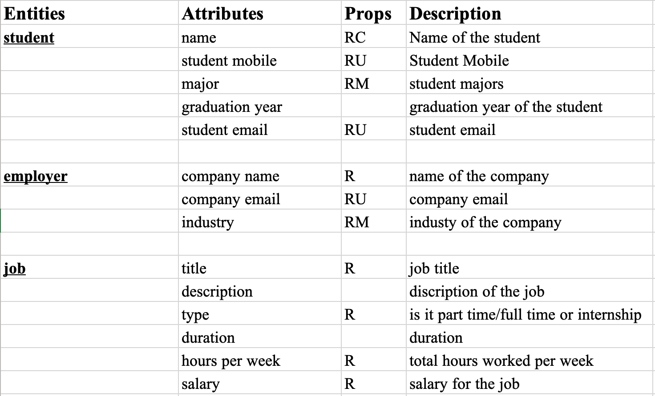
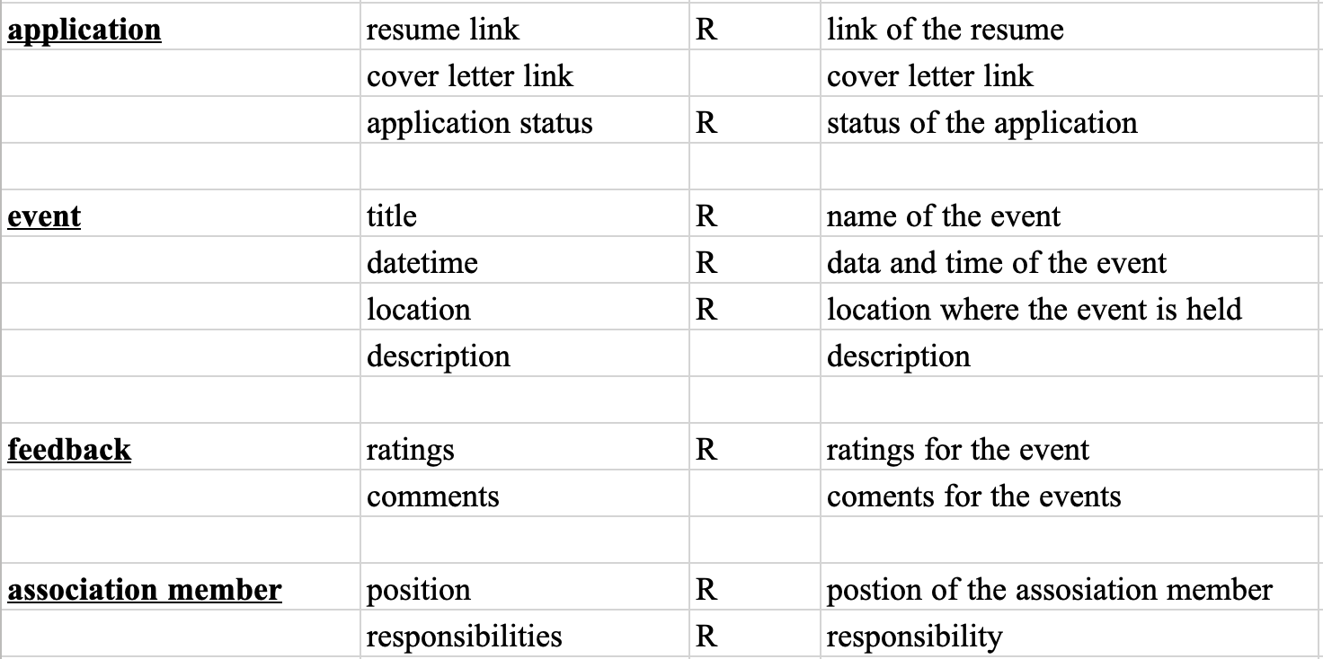
Requirements, Entities and Attributes

Slide 6
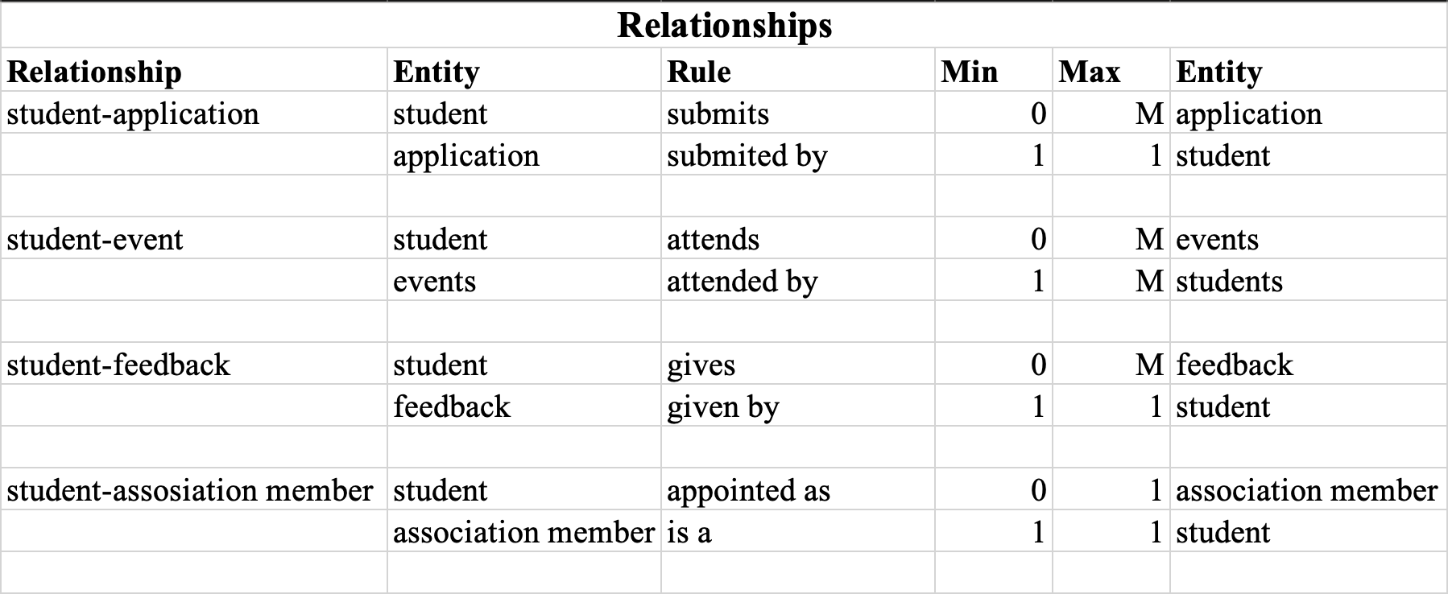
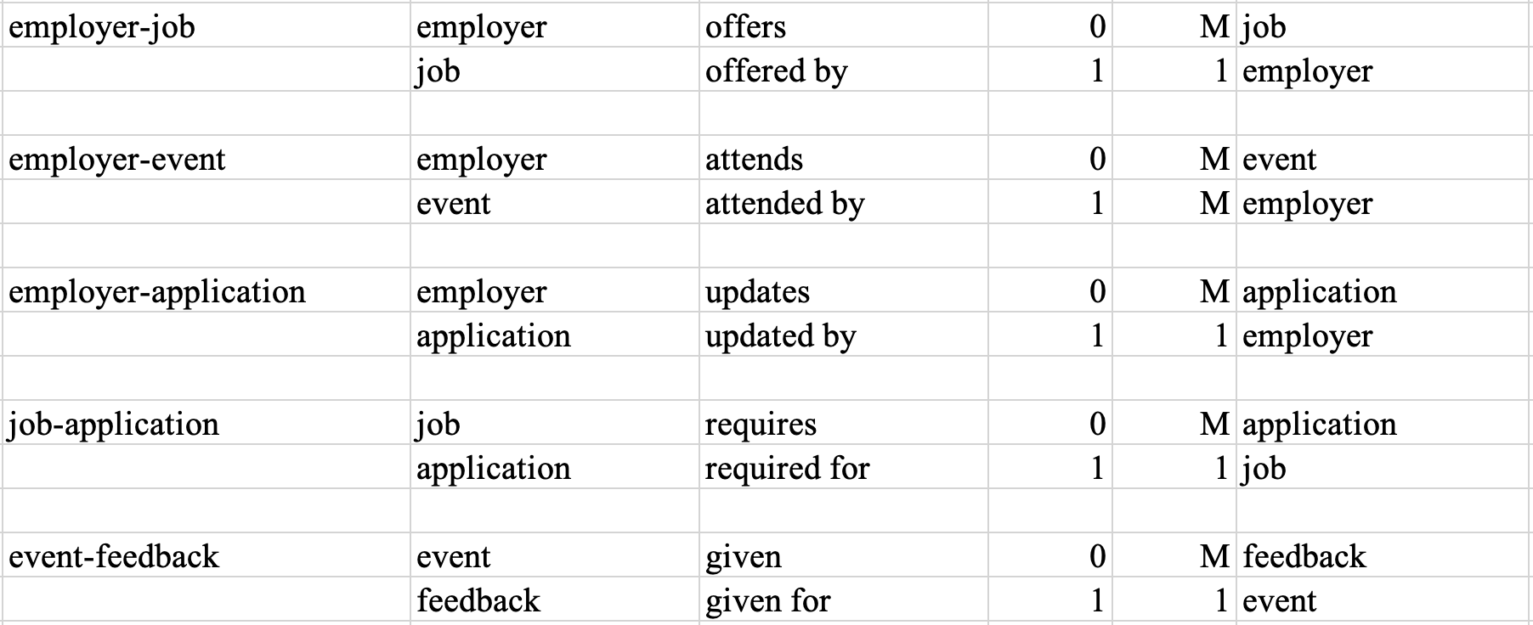
Relationships

Slide 7
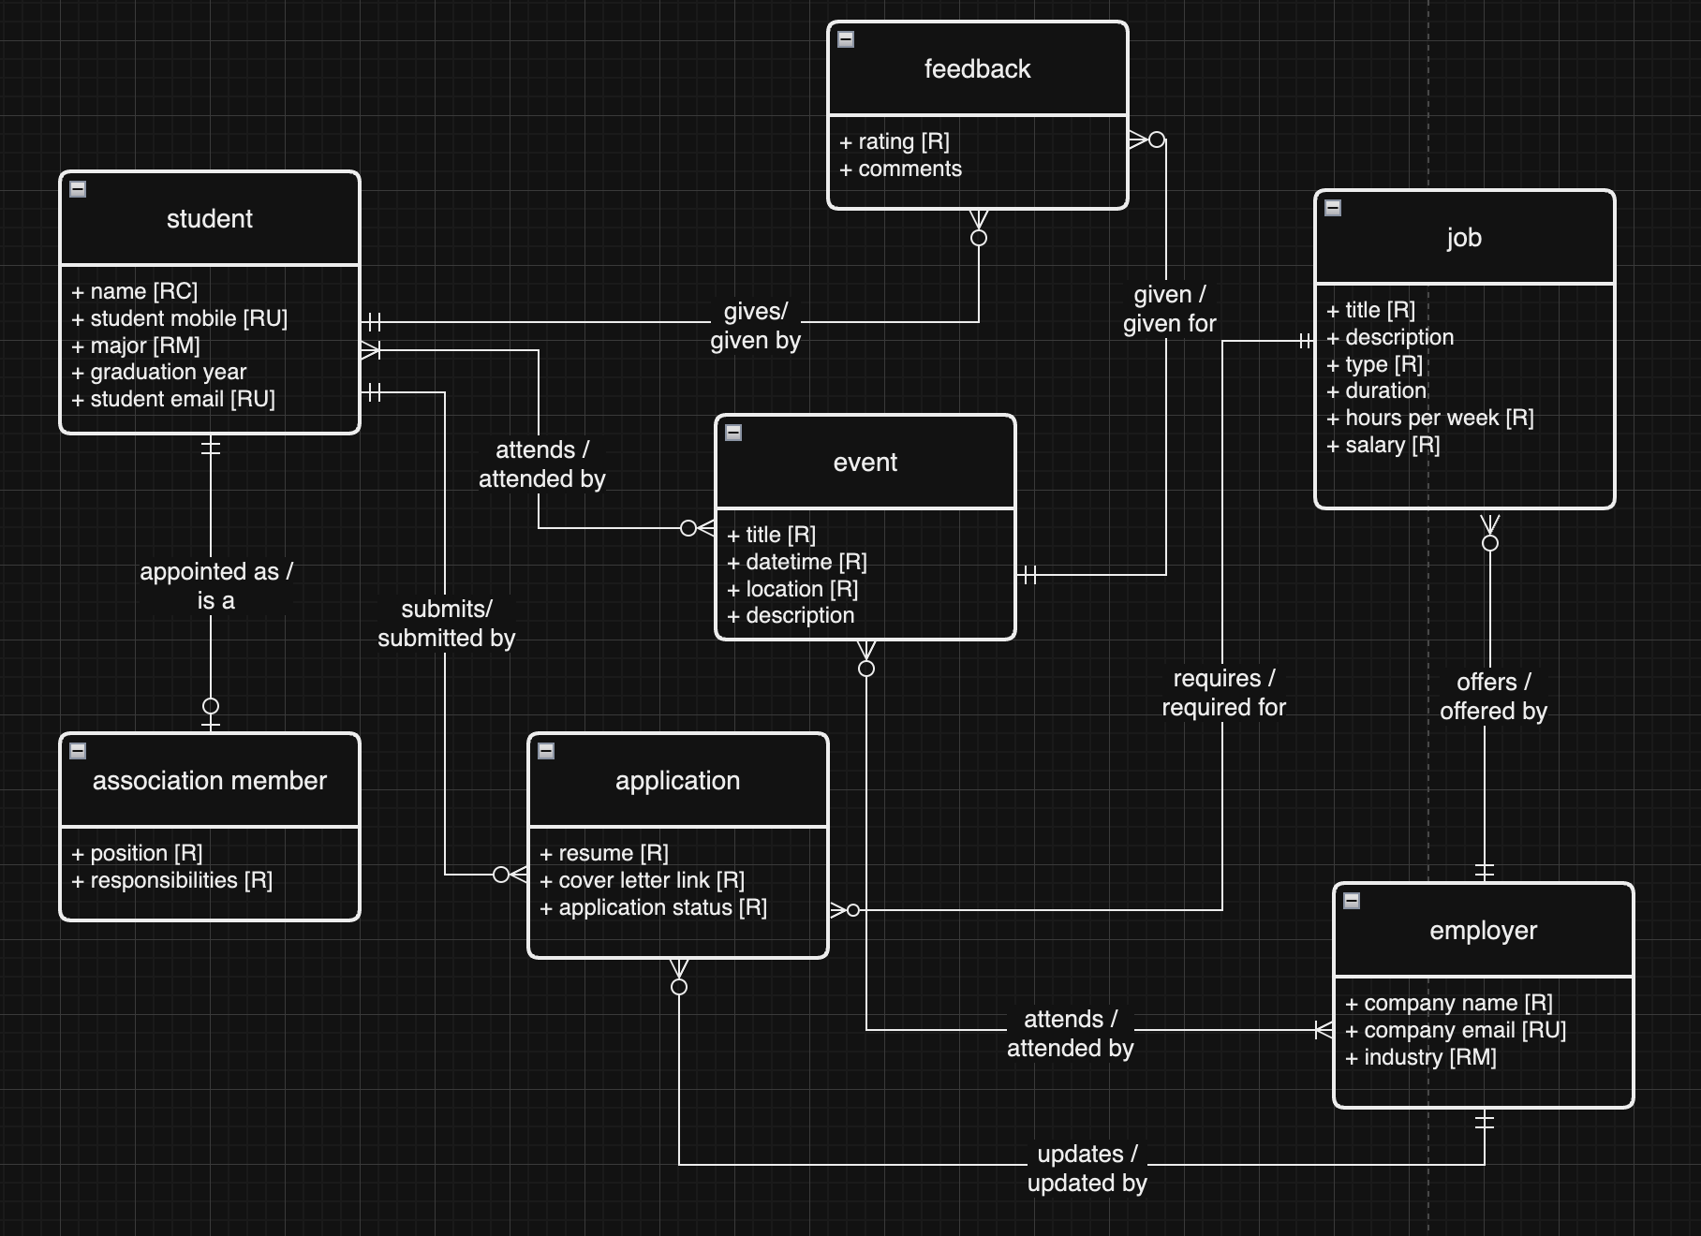
Conceptual MODEL

Slide 8
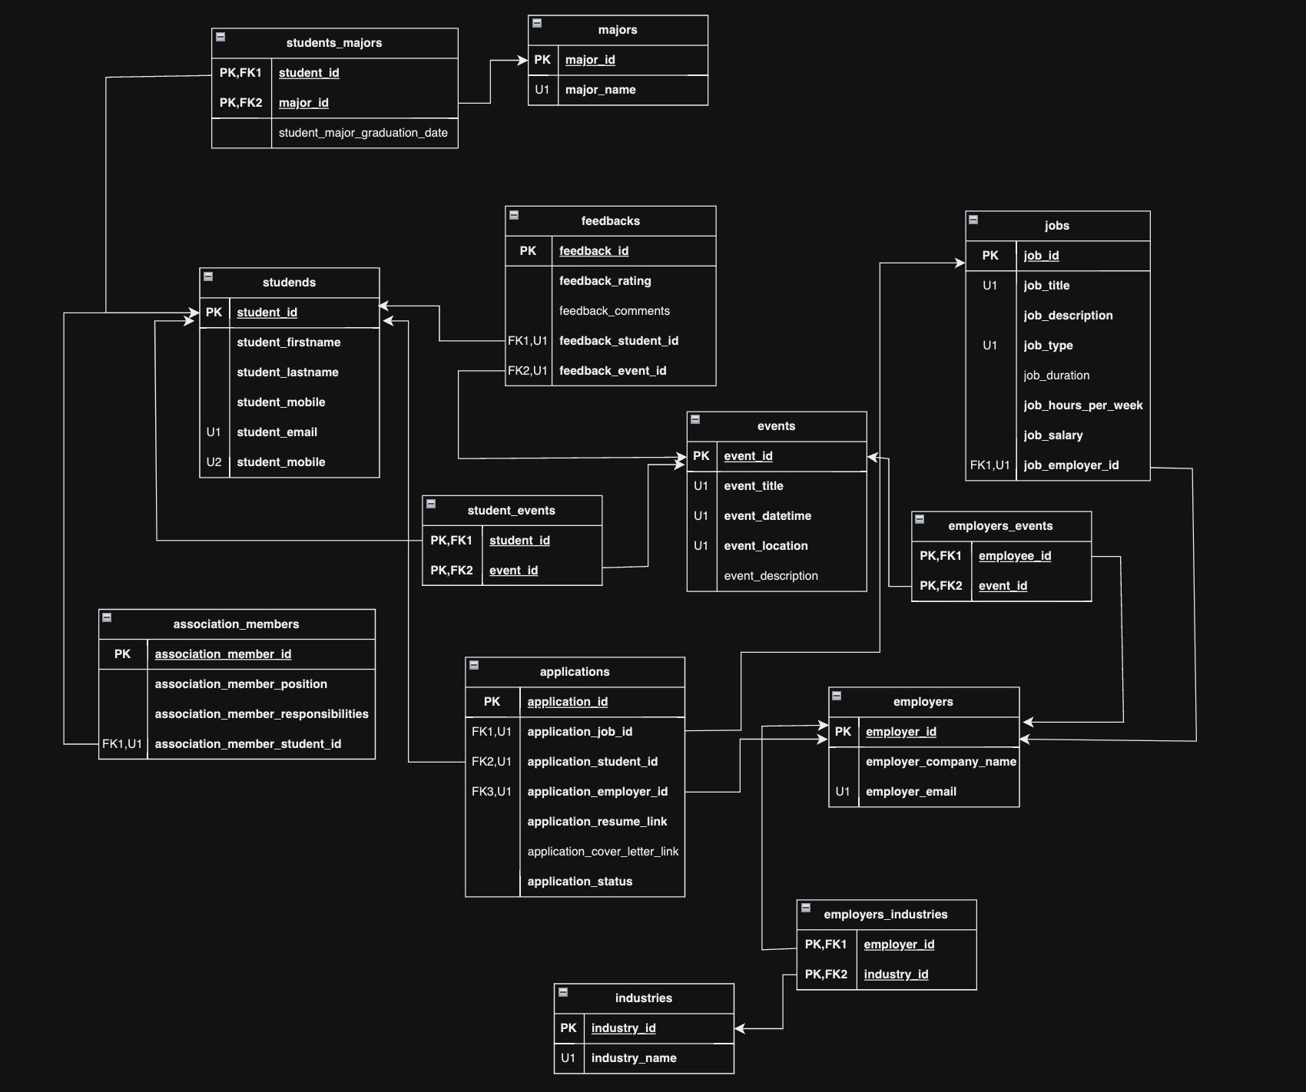
LOGICAL MODEL

Slide 9
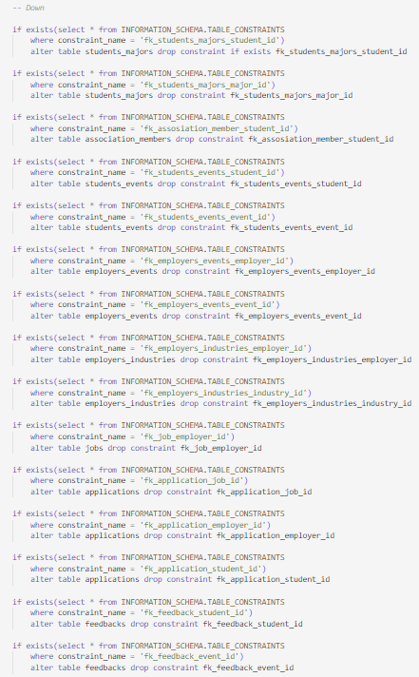
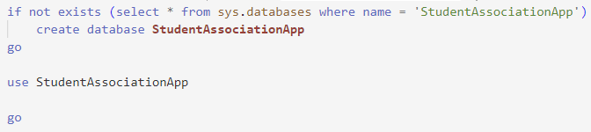
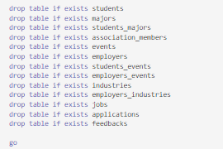
Up/Down SQL script

Slide 10
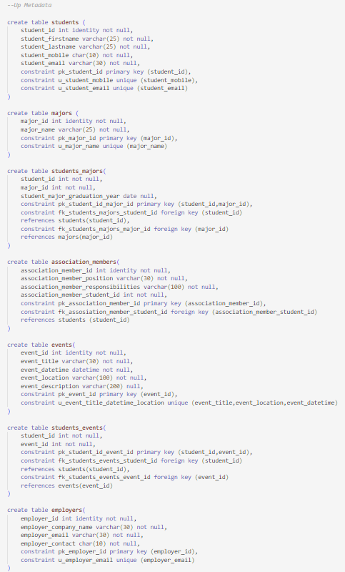
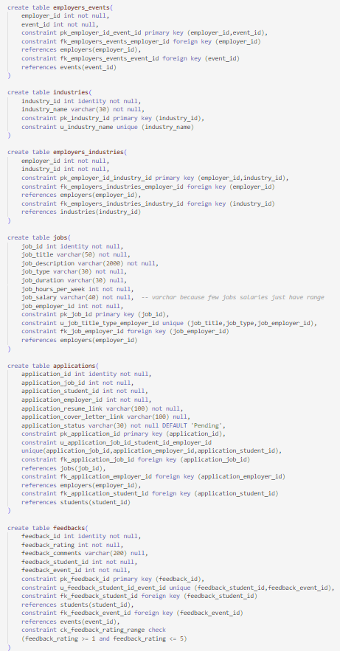

Slide 11
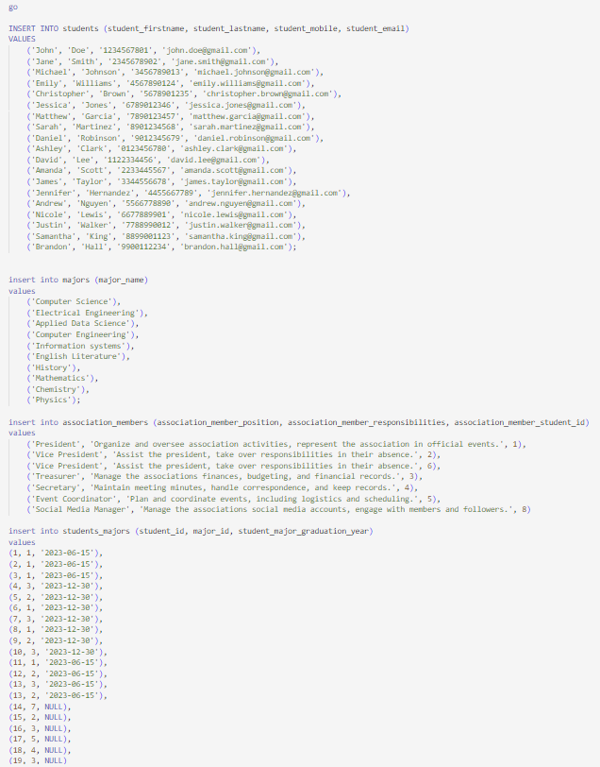
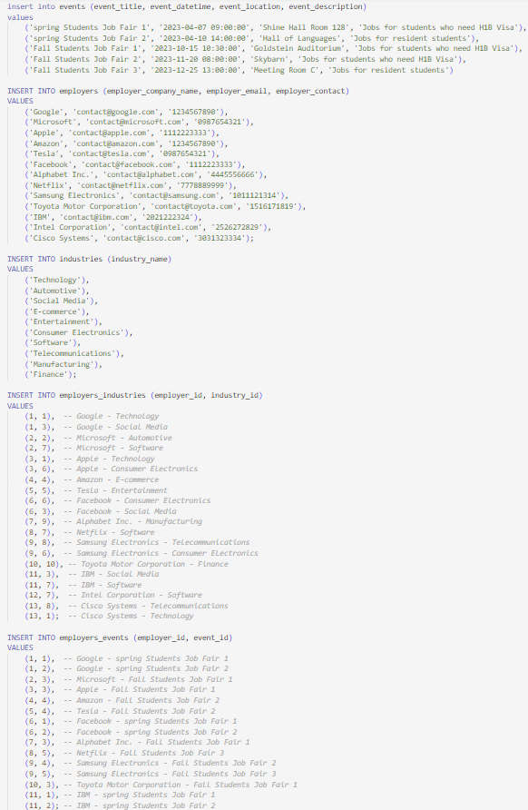

Slide 12
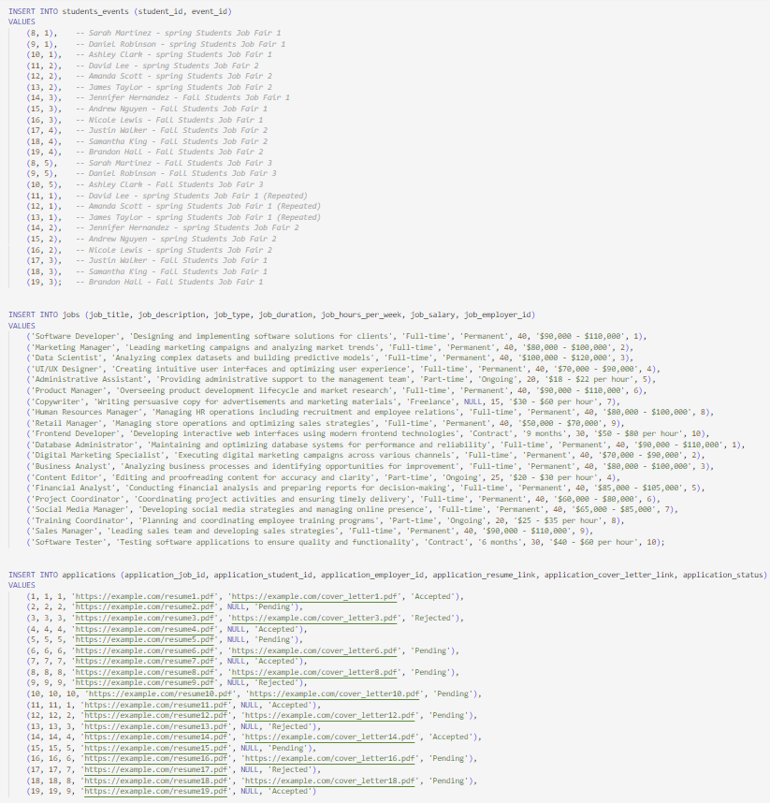
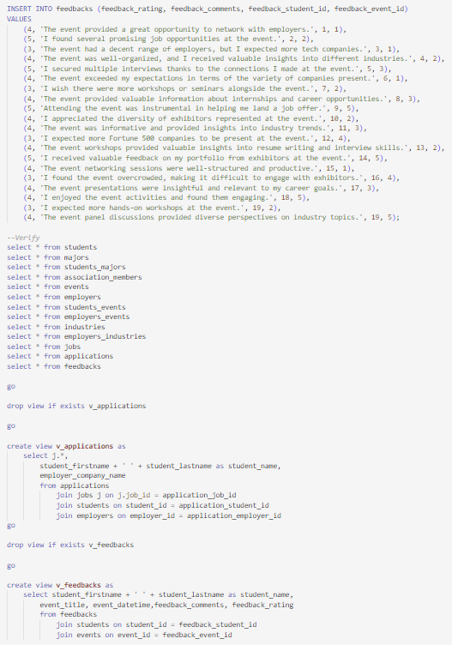

Slide 13
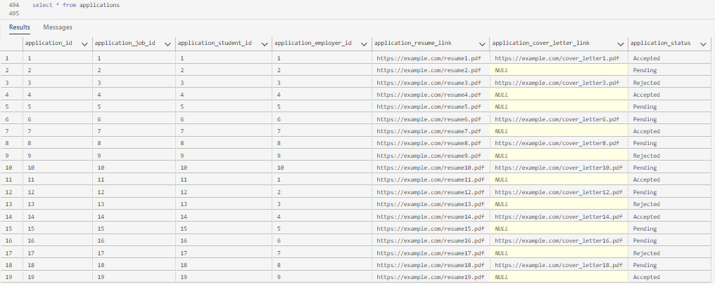
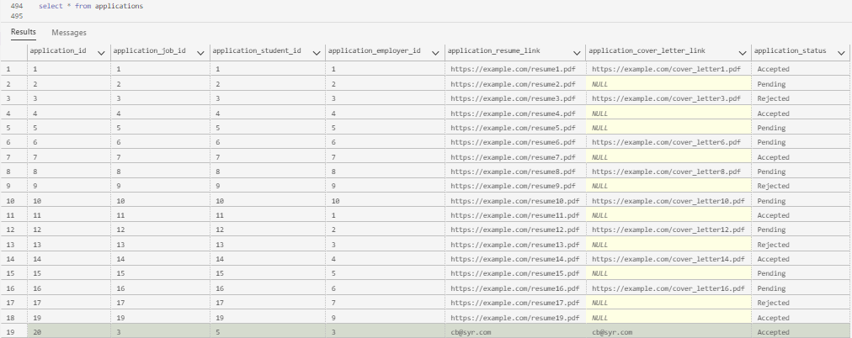
Application overview CRUD operation : Creating, deleting and updating application
Before
After

Slide 14
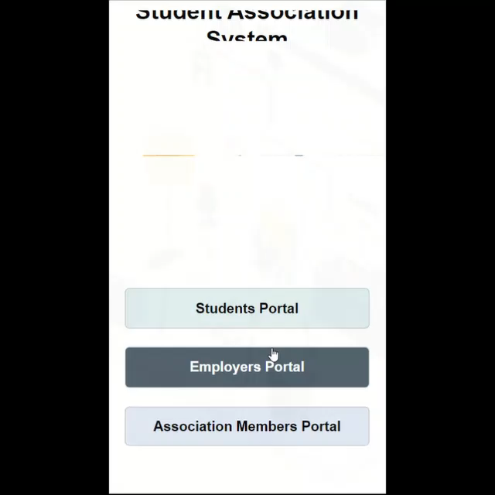

Slide 15
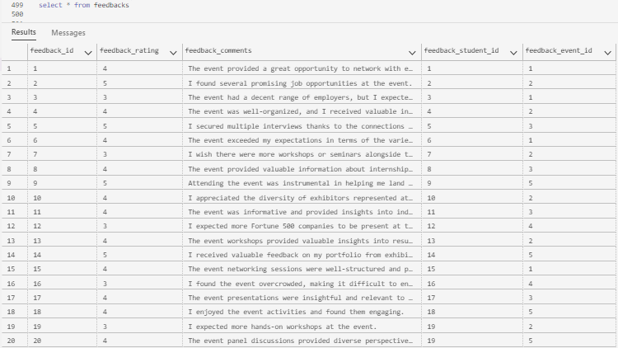
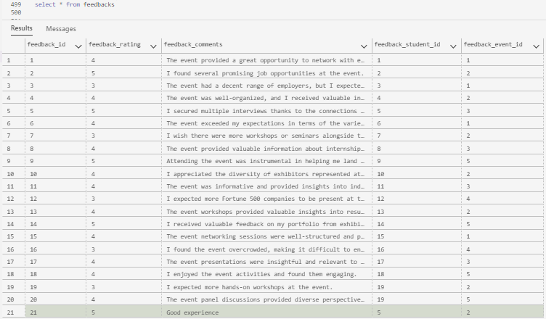
Adding Feedback
Before
After

Slide 16


Slide 17

Screens/Features
Home Screen
Profile Management for Students and Employers
Opportunity Listings with application functionality
View Events and Feedback Submission
Applications and Association Members Tracking

Slide 18
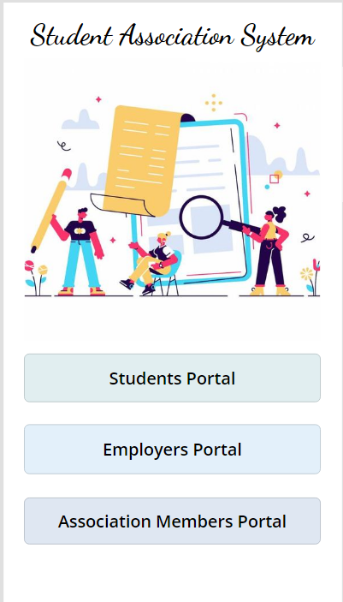
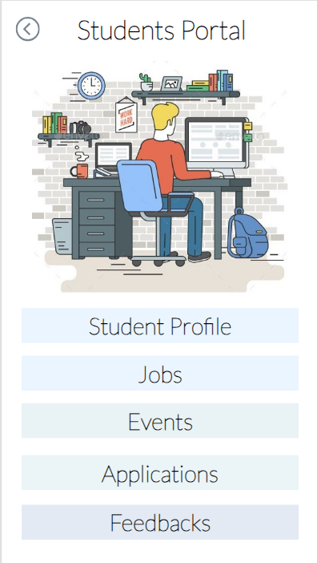

Slide 19
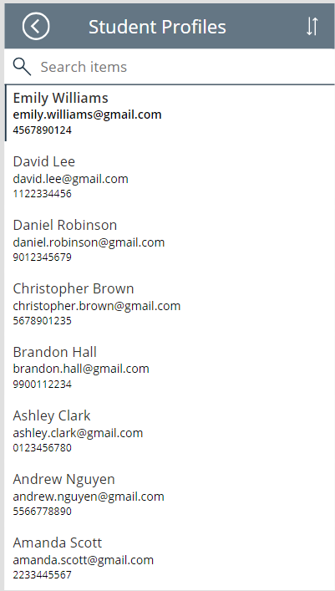
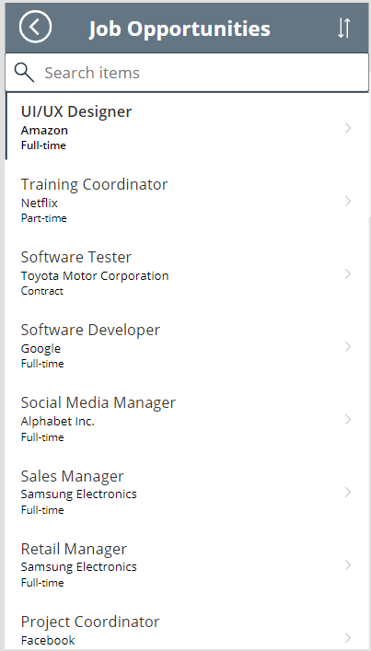
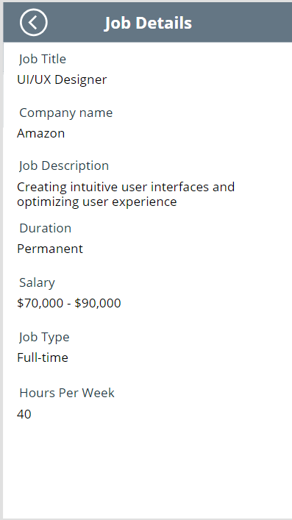

Slide 20
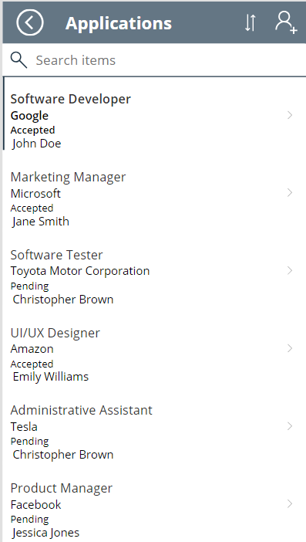
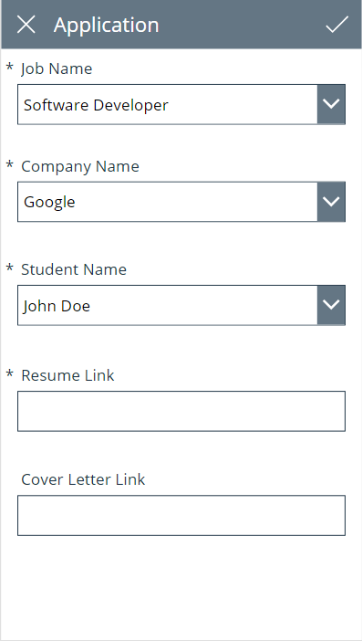
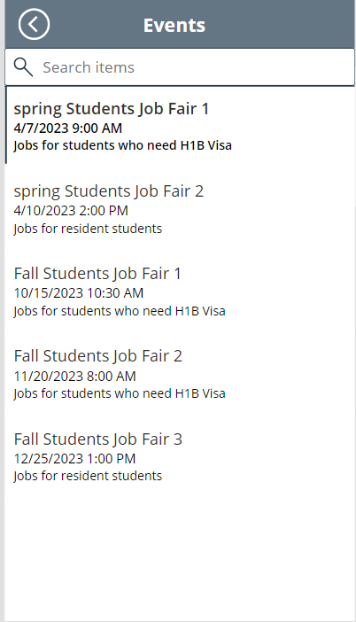

Slide 21
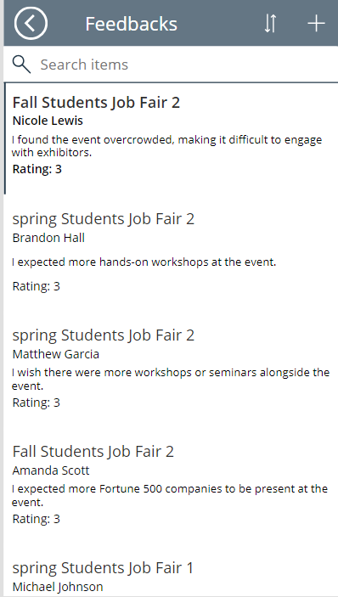
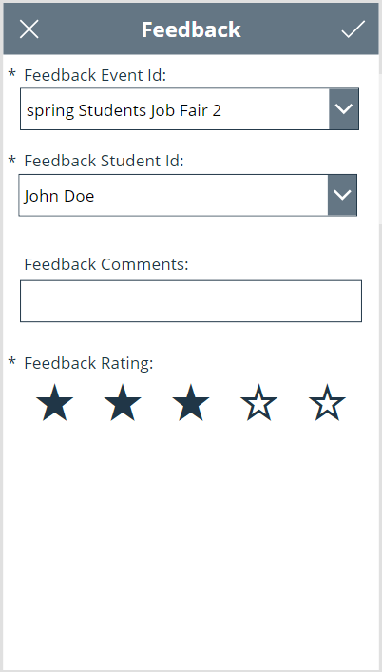

Slide 22
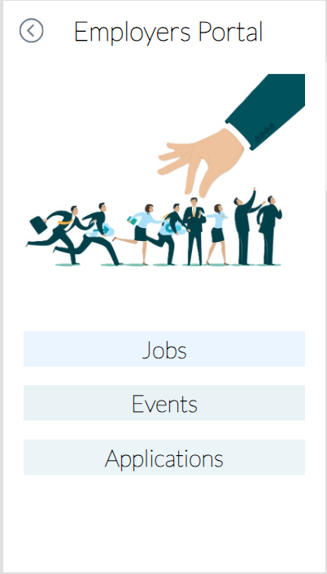

Slide 23
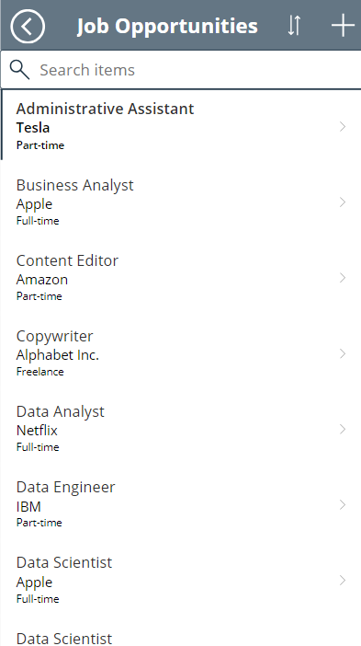
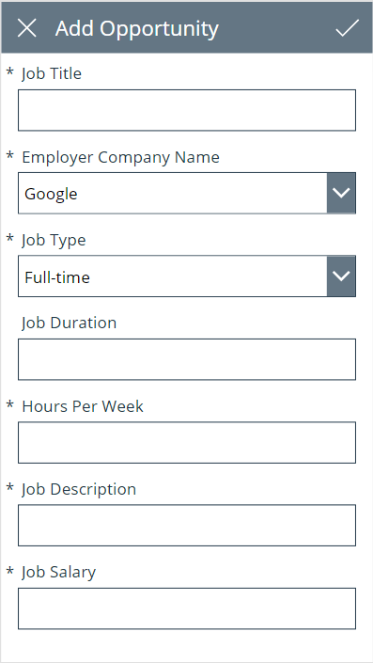
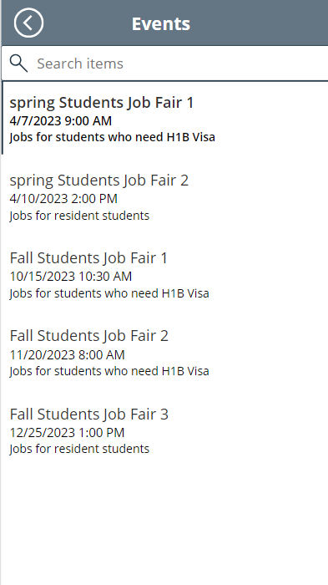

Slide 24
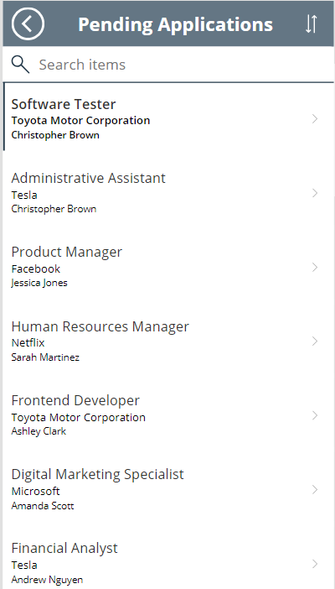
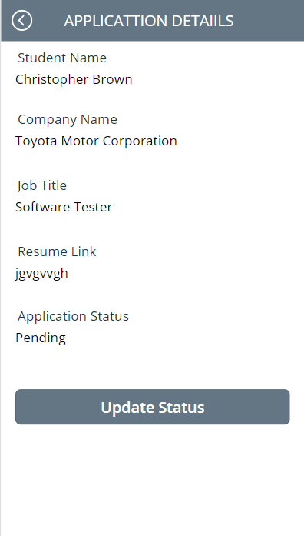
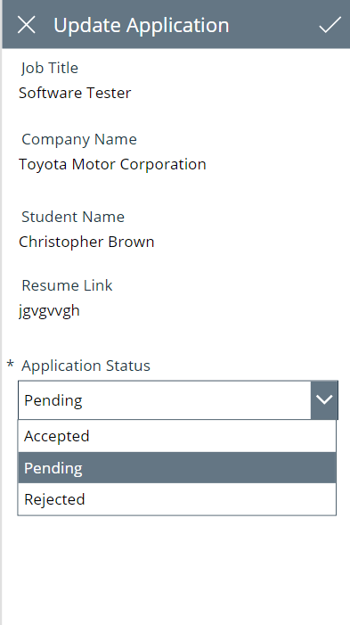

Slide 25
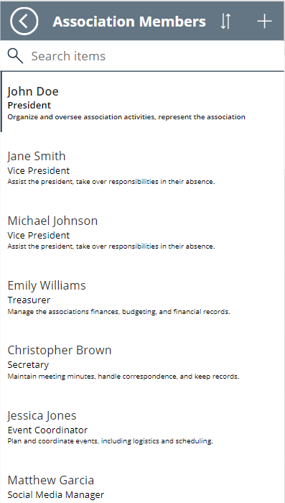
App Link:-
https://apps.powerapps.com/play/e/default-4278a402-1a9e-4eb9-8414-ffb55a5fcf1e/a/c57fcc48-e127-4c4b-9928-45699eff4fbd?tenantId=4278a402-1a9e-4eb9-8414-ffb55a5fcf1e&hint=b293e37f-1fab-4001-9d75-091e3477c807&sourcetime=1714628476962

Slide 26
User stories
As a student, I must be able to submit job applications, so that I can secure employment opportunities.
As an employer, I must be able to post job openings so that students can submit their applications
As an employer, I want to be able to review the job applications, so that I can efficiently manage student submissions.
As a student, must be able to participate in job events, so that I can explore job opportunities and apply accordingly.
As an employer, I must be able to participate in job events, so that I can engage with potential candidates and promote my company's opportunities.
As a student, I must be able to provide feedback on the job events I attended, so that I can share my experiences and contribute to improving future events.

Slide 27
team log
Team Member | Contributions
Vinay | Led the Requirements, Entity, and Attribute walkthrough. Was responsible for the Conceptual Data Model implementation. Led the Logical Data Model implementation. Developed the Up/Down SQL script. Oversaw the application user stories overview. Led the creation of Power Apps.
Roja | Drafted the project proposal and outlined the business problem. Co-led the Requirements, Entity, and Attribute walkthrough with Vinay. Contributed to the development of the application. Created and compiled the final PowerPoint presentation.
Nithin | Co-led the Requirements, Entity, and Attribute walkthrough with Vinay. Contributed to the development of the application. Co-Led the Logical Data Model walkthrough.

Slide 28
Thank You

